Slide 1


Customer Ratings Analysis And Insights
Piyali Goswami
30th October, 2023

Slide 2
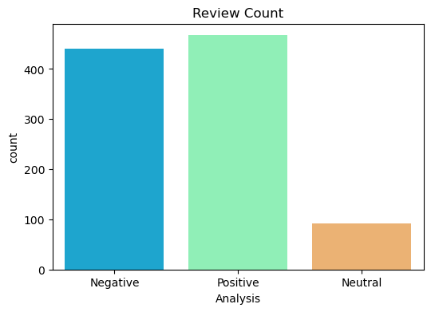
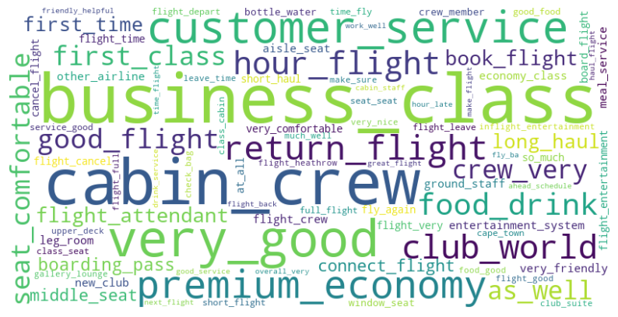
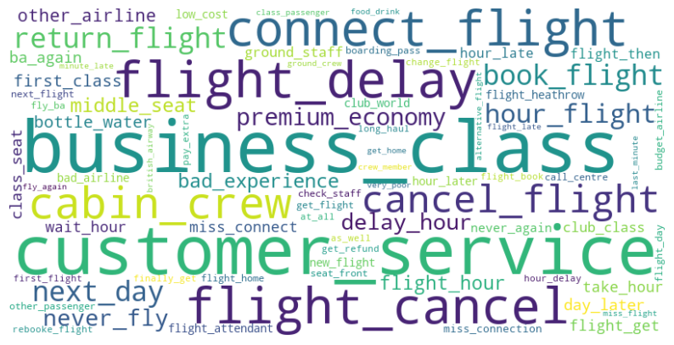
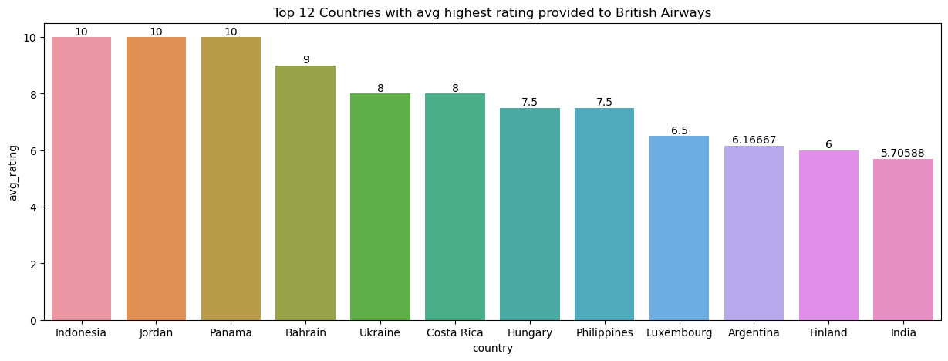
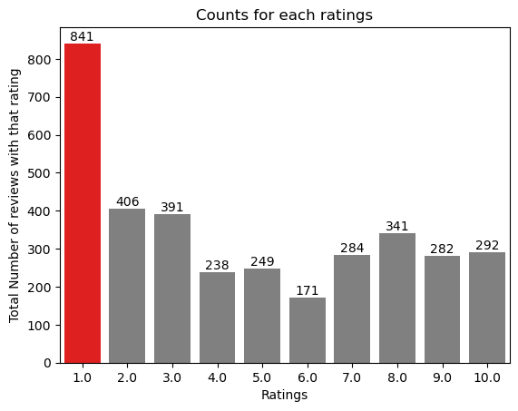
Key Insights
Total reviews
Collected
3495
Verified
2345
Review From
69
Countries
Not Verified
1150
Positive
Negative
Many travelled in Business class.
Most of the customers liked Cabin crew service and staff, general economy seats.
Need to focus on economy class service, seats, enhance inflight entertainment experience and importantly Delays.
Enhance the experience of business class, it seems customers want value for money. Improve Customer service on refund requests and process.

